Slide 1
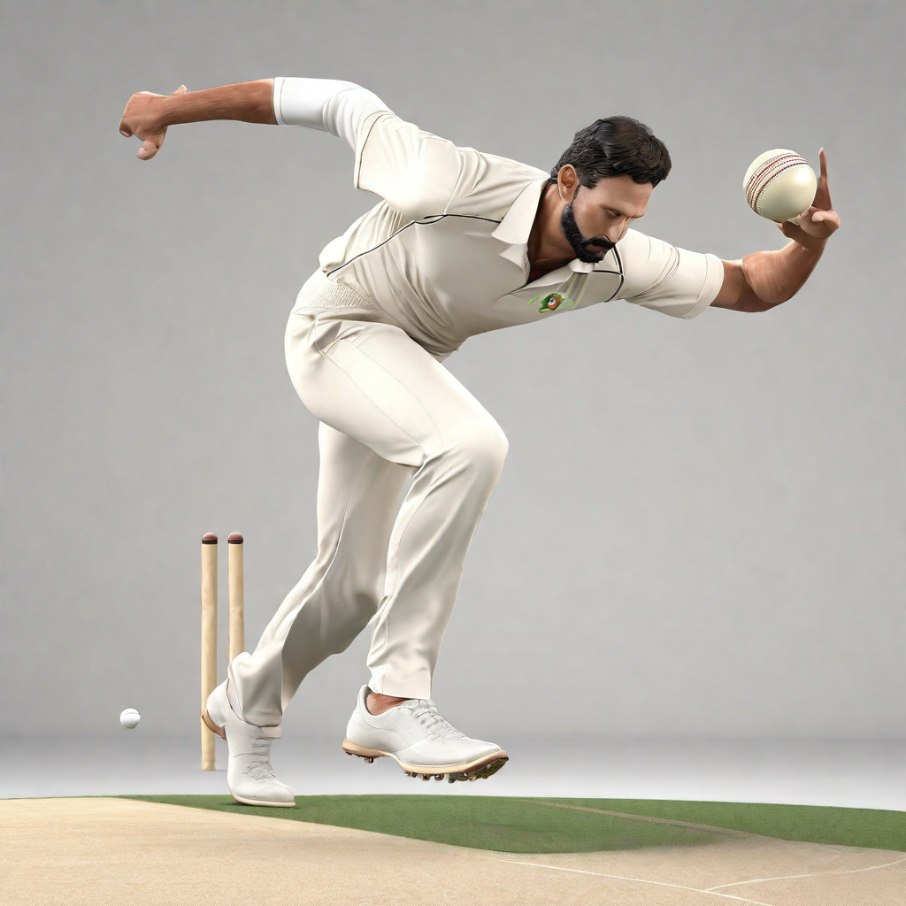
Cricket Bowling Pose Analysis
Unveiling the Dynamics of Style Transformation Post-Injury
By - Subhash B S

Slide 2
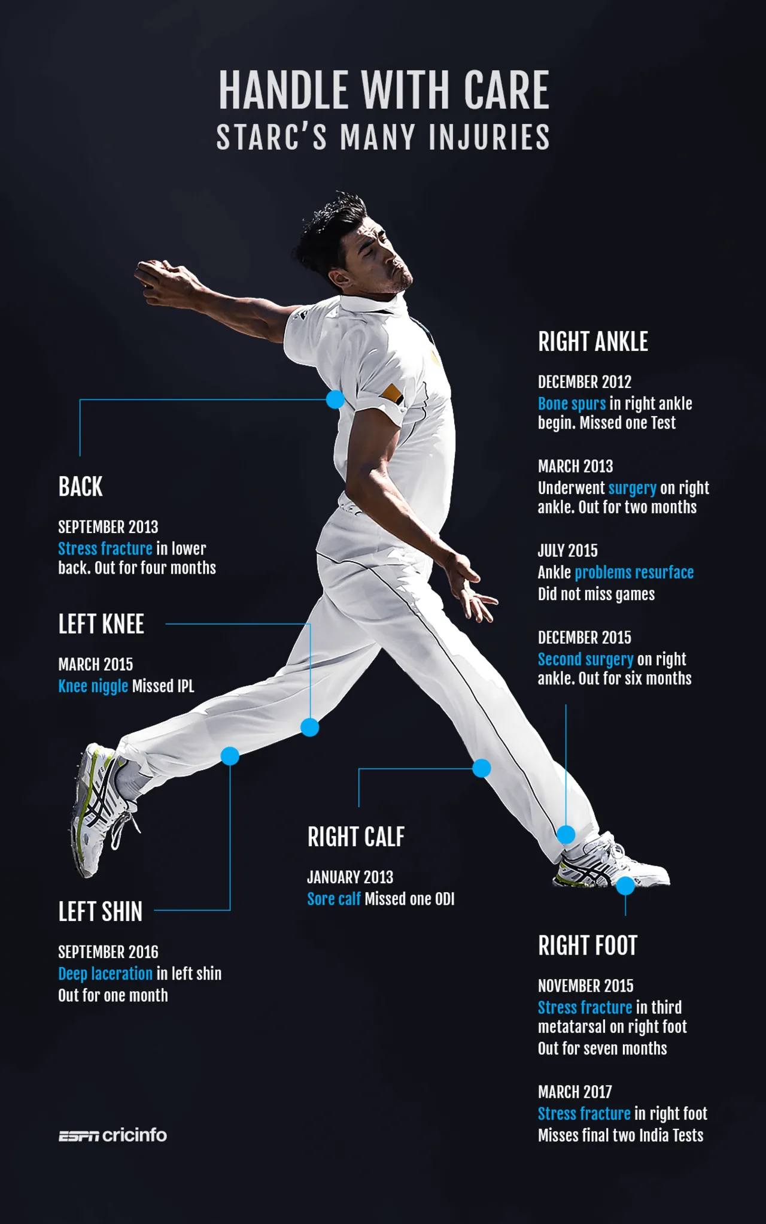
Motivation
The motivation behind the project lies in the need to gain a nuanced understanding of how injuries reshape cricket bowling techniques. Injuries are a common occurrence in cricket, and they can have a significant impact on a player's performance and style of play.
By analyzing the dynamics of style transformation post-injury, we aim to uncover valuable insights that can help players, coaches, and medical professionals in the rehabilitation process.

Slide 3
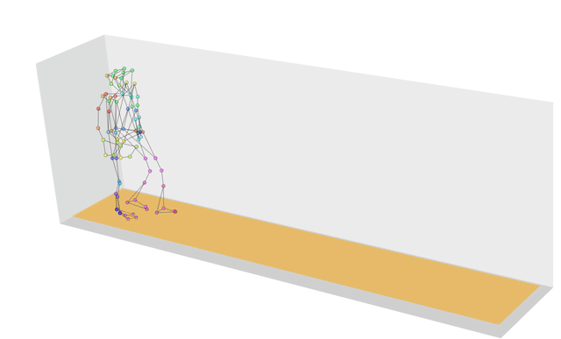
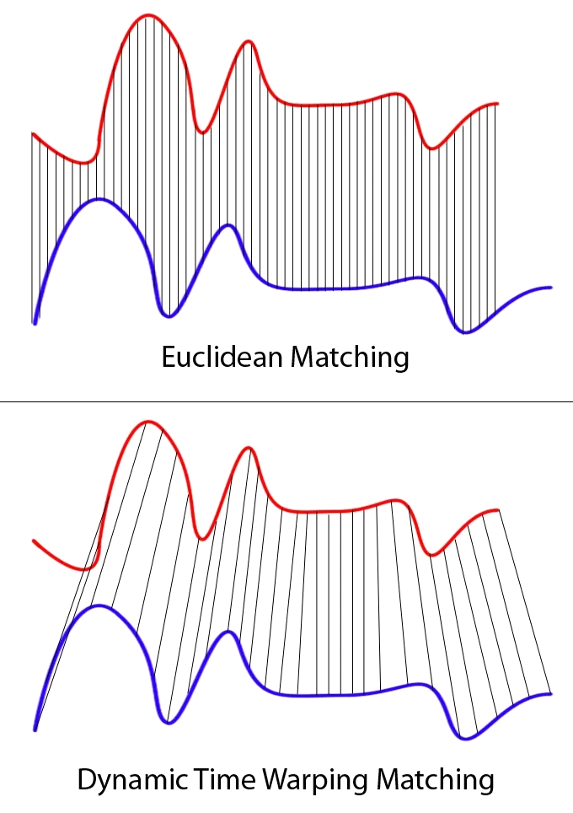
Methodology
Pose Recognition with MediaPipe:
Utilize the advanced pose recognition capabilities of MediaPipe for real-time, accurate pose detection in bowling sequences.
Leverage the pose landmarks to capture dynamic movements and positions during each frame.
Dynamic Time Warping (DTW):
Implement Dynamic Time Warping to effectively compare bowling sequences, considering variations in speed and timing.
Uncover subtle differences in bowling style, providing a comprehensive view of the post-injury transformation.
Dataset:
Showcase the curated dataset, comprising pre and post-injury bowling videos, ensuring diversity in techniques and skill levels.
Fig. DTW

Slide 4
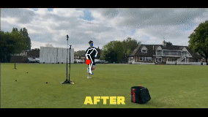
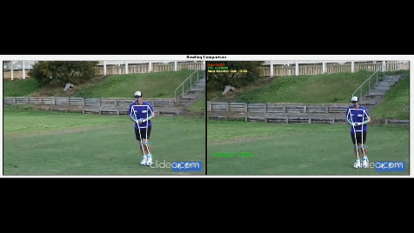
Implementation
Fig. Pose estimation
Fig. Pose Alignment with DTW

Slide 5

Bowling Analysis Tool
AI-powered Analysis
Our innovative AI technology enables us to decode the secrets behind cricket bowling transformations. Through advanced analysis, we can uncover the subtle changes in technique that occur post-injury.
Captivating Visualizations
Using engaging visuals and demonstrations, we bring the power of AI to life, showcasing the dynamic nature of cricket bowling and the transformative impact of our analysis.
Fig. Pose estimation with DTW

Slide 6
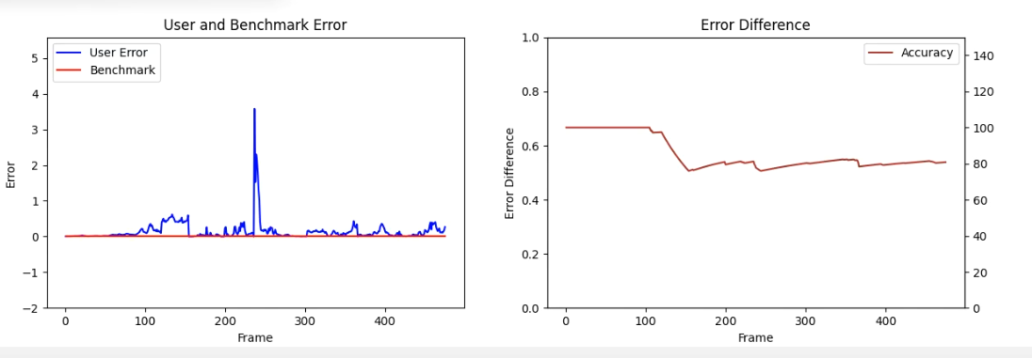
Captivating Results

Slide 7
Refinement and Expansion
🏈 Advanced Biomechanical Analysis
The project has the potential for further refinement and expansion in the field of cricketing biomechanics.
👨‍🏈 Player-Specific Analysis
By collecting and analyzing data from a larger sample of players, the project can provide insights into the biomechanical variations among different individuals.
🏀 Performance Enhancement
The project can be expanded to include an analysis of the impact of different bowling techniques on performance, allowing players to optimize their style and improve their skills.
📖 Injury Prevention
By studying the biomechanics of bowling techniques, the project can contribute to the development of injury prevention strategies and techniques, helping players maintain their physical well-being.

Slide 8
Conclusion
Key Findings
Through the use of innovative 3D rendering techniques, we were able to analyze cricket bowling poses in unprecedented detail.
Our analysis revealed subtle variations in bowling techniques, allowing us to identify key factors contributing to style transformation post-injury.
By studying the dynamics of style transformation, we gained valuable insights into the biomechanics of cricket bowling and potential areas for improvement.
Invaluable Insights
Our findings have the potential to revolutionize cricket training programs, enabling coaches and players to optimize bowling techniques and prevent injuries.
The detailed analysis of bowling poses provides a foundation for future research and development in the field of cricket biomechanics.

